Slide 1
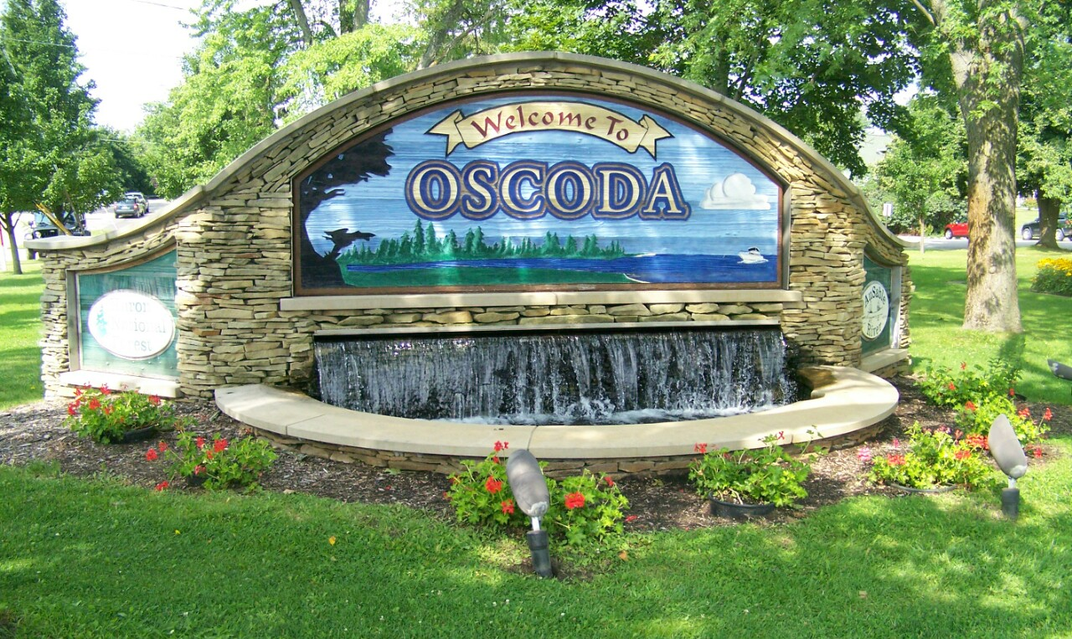
DOWNTOWN SUMMIT

Slide 2
Economic Improvement Committee Stakeholder Survey
128 responses between June 22 and July 28
Average response time: under 4 minutes!
Thank you for sharing and contributing

Slide 3
Parking

Slide 4
Question 1: Do you feel like the downtown district has enough public parking available?

Slide 5
Question 2: As a business owner with parking available in the downtown would you be interested in working with the township to develop a working plan for public usage of your parking?

Slide 6
Vibrancy

Slide 7
Question 3: Do you feel the downtown district could benefit from a vibrancy grant program?

Slide 8
Question 4: If a Vibrancy Grant program was implemented, would you be interested in participating in a township match type program?

Slide 9
Public Art

Slide 10
Question 5: Does the downtown district need more public art (murals on buildings, sidewalk art, standalone structures)?

Slide 11
Question 6: What type of public art would you like to see and where?
MURALS

Slide 12
Micro & Pop-up Retail

Slide 13
Question 7: Do you think Micro and/or Pop-up Retail can be successful in the downtown district?

Slide 14
Question 8: Would your business be interested in participating and/or leasing space (land or building) to potential micro or pop-up retail vendors?

Slide 15
Question 9: Do you like the idea of a weekly pop-up retail event at a specific location (Dwight St, Furtaw Field, River Rd, Beach Park)?

Slide 16
Question 10: What are the best locations for pop-up retail in the downtown area?
Furtaw Field
Beach Park
Dwight Street

Slide 17
Question 11: What do you believe is the most critical task for the EIC to focus on? What would you like to see the EIC prioritize?
Downtown
Businesses/Shops
New Businesses
Empty Storefronts

Slide 18
Question 12: Other Comments
Attracting new business
Collaborate with existing businesses
Art and vibrancy
Building community

Slide 19
Thank you for your participation!

